Slide 1
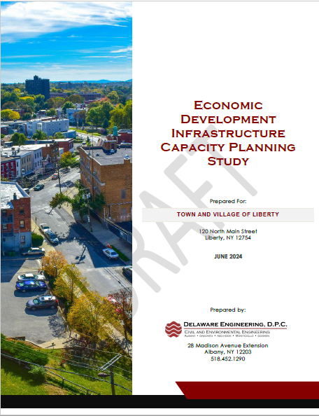
Joint Town and Village Board Meeting Infrastructure Capacity Planning Study Overview
119 N. Main Street, Town of Liberty Town Hall
June 25, 2024

Slide 2
Discussion Points
Study Background and Purpose
Methods
Findings
Parksville Sewer Feasibility Study Update
Recommendations

Slide 3
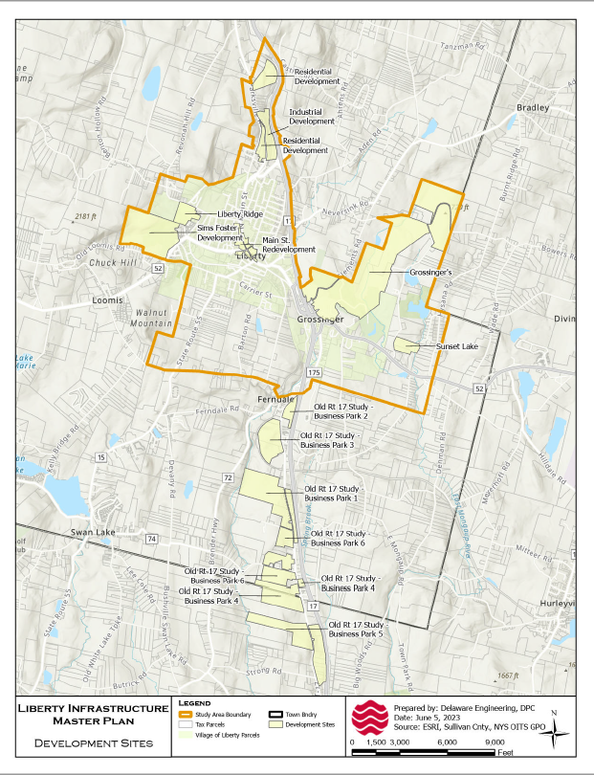
Background and Purpose
Investment Interest in the Town and Village
Land Development Proposals
Old Route 17 Corridor Study
Supporting Infrastructure Needs
Capacity – existing, needed, timing
Inventory/Mapping, Existing Conditions
Town-Village Collaboration
Sustainability of Town and Village Infrastructure
Investments in Aging Systems
Regulatory Demands
Labor and Staffing
Budget and Financing Costs
Roadmap and Policy Framework for Public Infrastructure

Slide 4
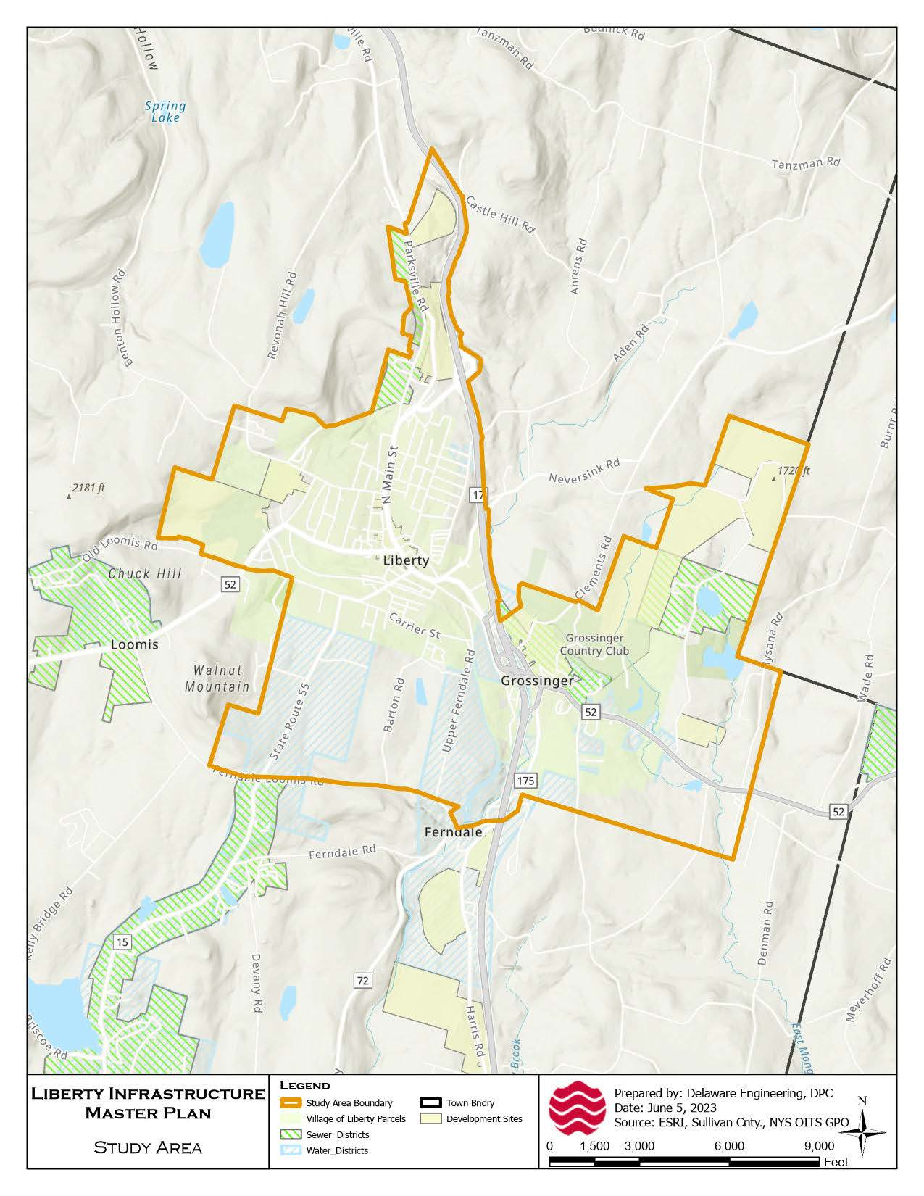
Study Methods Overview
Methodology
Define Study Area
Data sources
Interviewed Town and Village Leadership and Staff
Site visits
Recommendation from Prior Planning Efforts,
Review of Land Development Project Proposals
Estimate of Village of Liberty Main Street redevelopment
Previous Engineering Efforts
Regulatory Filings
Broad definition of infrastructure: Water, Sewer, Storm Sewer
Identify and Prioritize: potential infrastructure projects; develop recommendations
Review Infrastructure Budgets, Financing Options
Parksville: Sewer Feasibility Study (FS) update

Slide 5

 | Water Supply and Distribution | Sanitary Sewer Conveyance and Treatment | Storm Sewers
Opportunities | Elm St. Well & Lily Pond Design Capacity Potential Spare Capacity in Town Water System Town-Village Interconnection Points Distribution System Coverage Extends within Close Proximity of Development Sites | Available Capacity of Village WWTP Existing Interconnections Capacity Increase elsewhere in Town System (Swan Lake WWTP)
Needs & Challenges | Lily Pond Source Water Issues, WTP Investment Needs Elm St. Well Contamination; Short-term needs include New Pumps, Electrical Upgrades, and Auxiliary Power Capacity of Town water sources Restrictions/Bottlenecks in Town and Village Distribution Systems Lead Service Lines Seasonality of Demand | Gravity Main Green Ln./Chestnut St./West St. Days Inn Pump Station Capacity Inflow & Infiltration Seasonal Demand Permit Changes Affecting Village’s WWTP | Aging Infrastructure Recurring Flooded Areas along Main St. in The Village Changing Climate Patterns.
Findings

Slide 6
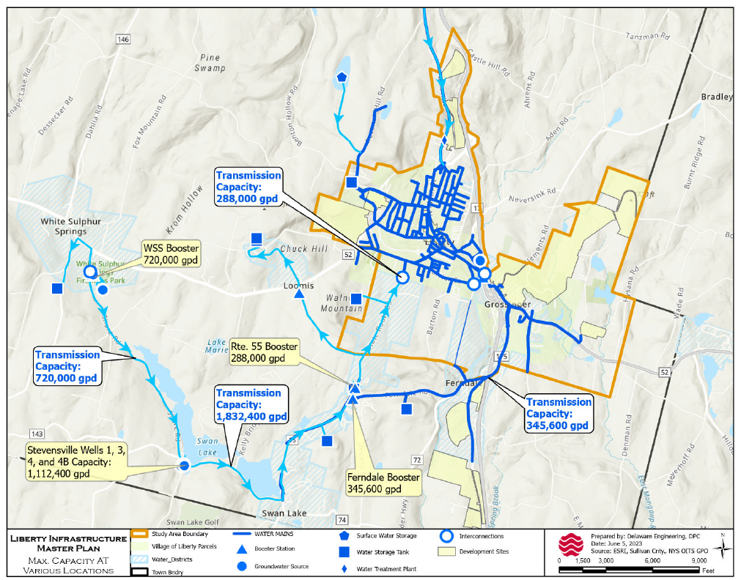

Slide 7
Parksville Sewer Service Feasibility Study Update
Findings:
60 parcels, 44 Improved; ~29,000 GPD
2021 FS: Three Alternatives
Update: Evaluate subsurface disposal system (SSDS)
Alt. 4: gravity/grinders, pump station
Alt. 5: grinders only, low pressure lines, pump station
SSDS requires about 5 acres
Next Steps:
Subsurface Disposal System Real Estate Option
Prepare Engineering Report
Outreach to assess property owner interest
Grant Funding has potential to reduce user costs from more than $3,000 to approx. $1,000 per year

Slide 8
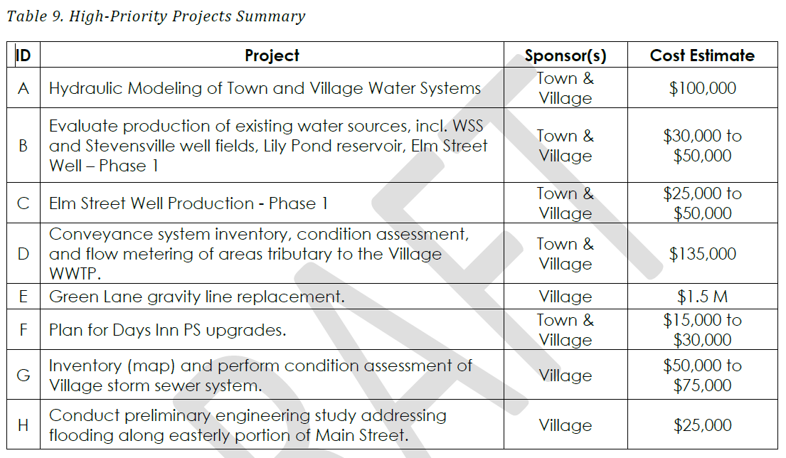
Recommendations – High-Priority Projects
Refer to DRAFT “Economic Development Infrastructure Capacity Study Plan prepared for the Town & Village of Liberty, June 2024”

Slide 9
High-Priority Projects Implementation
Memorandum of agreement for advancement, funding, and implementation between Town Board and Village Board
Funding assistance:
Empire State Development (ESD) Strategic Planning and Feasibility Studies Program – tie to economic investment
USDA Water & Waste Disposal Predevelopment Planning Grant
Own source revenue
Progress on Elm Street Well Production – Phase 1

Slide 10
High-Priority Projects Implementation
Project scoping
Identifying funding opportunities
NYSEFC Engineering Planning Grant (EPG) - $50,000 (requires 10% cash/in-kind services match)
Empire State Development (ESD) Strategic Planning and Feasibility Studies Program – tie to economic investment
USDA Water & Waste Disposal Predevelopment Planning Grant
Own source revenue

Slide 11
High-Priority Projects Implementation
Next steps are driven by opportunities to fund the project:
Community Development Block Grant (CDBG)
up to $1 M available
projects must be ready for construction
In order to access CDBG grants, final plans must be developed:
Own-Source Revenues, including Bonding
Future Sewer District Extensions – private sector investments in the Study Area provide opportunity to spread capital costs among those benefitting
NYSEFC Engineering Planning Grant (EPG) - $50,000 (requires 10% cash/in-kind services match) – does not support final design plans

Slide 12
High-Priority Projects Implementation
Create arrangement between the two municipalities, whether an MOA or board resolutions, to establish the project as a collaborative effort.
Funding sources
Fair-share contributions made as part of land development projects that require increases in capacity
Empire State Development (ESD) Strategic Planning and Feasibility Studies Program –
tie to economic investment
this project could be included in a larger, comprehensive effort aimed at upgrading multiple systems
NYSEFC Engineering Planning Grant (EPG) - $50,000 (requires 10% cash/in-kind services match) – does not support final design plans
In-flight grant application

Slide 13
High-Priority Projects Implementation
Identify a project lead and develop a scope and budget
Own-source revenue most likely required, but there are opportunities to leverage other inventorying efforts to advance it (e.g., creation of a common GIS database)
Integrate inventory and assessment information into existing public works workflows and tasks (e.g., similar to a “windshield” pavement condition assessment)
Develop a project scope and seek grants
Delineate specific problem area
Identify flooding sources
Document Private vs. public storm sewer ownership
Grant funding sources:
NYSDEC WQIP
NYSDEC Nonpoint Source Planning Reports Program ($30K for certain types of projects involving green infrastructure, stream corridor assessments)

Slide 14


Finance and Governance
 | Analysis and Recommendations
Village | Provide Expenditures Detail in Village Budget to capture cost to produce water e.g., staffing costs, equipment, contractual services, etc. Establish Fund Balance Target and policy to “right-size” amount held in reserve study identifies existing conditions as: Sewer Fund: 20% of expenditures Water Fund: 60% of expenditures → surplus balance can be used to offset needed capital projects Rate restructuring to support transparency, equity, effective budgeting, fiscal resiliency, and addressing long-term capital needs Tie rates to costs of providing the service Benefit-based framework Shared Services – Leverage overlap in resources, knowledge, and operational demands where both municipalities are providing a service (e.g., water and sewer) Can be consolidation of operational resources and functions creating water or sewer authorities to manage this infrastructure on behalf of users
Town | District Consolidation Existing Conditions: Sewer Districts - Four (4) Water Districts - Seven (7) Overlaps of Administrative Resources (in terms of infrastructure) Shared Services – Same opportunities and benefits as listed above

Slide 15
Questions?

